Slide 1
ONLINE QUIZ PORTAL
By,
Ankita Khandekar
Batch-7582

Slide 2
Objective :
To Design and Implement a online platform which is used for taking up online Quizzes in different Topics.

Slide 3
Technologies used :
Frontend-Angular :
Angular is a platform and framework for building single-page client applications using HTML and Typescript.
Unlike some of the other frameworks that offer one-way data binding, the Angular framework provides two-way data binding.

Slide 4
Backend-Spring Boot:
Spring Boot is an open source Java-based backend framework used to create a micro Service.
It provides a flexible way to configure Java Beans, XML configurations, and Database Transactions.
It offers annotation-based spring application.It supports all Spring Core/MVC/REST annotations.
Database-MySQL:
MySQL is an open-source relational database management system

Slide 5
Flow Chart of the Application:
HOME PAGE
Admin and User Login
User Registration
LOGIN
REGISTERATION
Admin Login
User Login
ADMIN
USER

Slide 6
ADMIN
Admin profile
Profile
Topics
Questions
Categories
add new Topics
add and delete Questions
Add Categories
quizzes
update info
regarding quiz
Quizzes
Delete the quiz
Delete
add new quiz
Update
Add Quiz
logout
Logout

Slide 7
User
User profile
All Quizzes
Take quiz
Start
Read Instructions
Start quiz
After attempting quiz
Submit quiz
New quiz
print result
Home
Result
Print
Logout

Slide 8
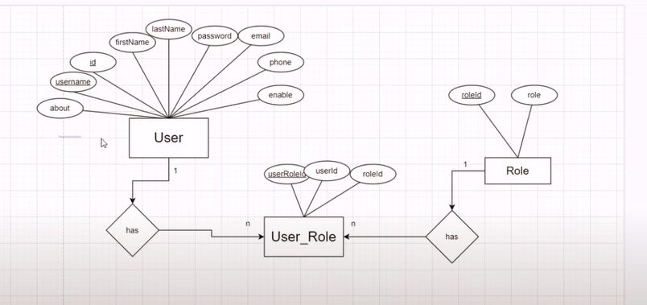
Entity Diagram:

Slide 9
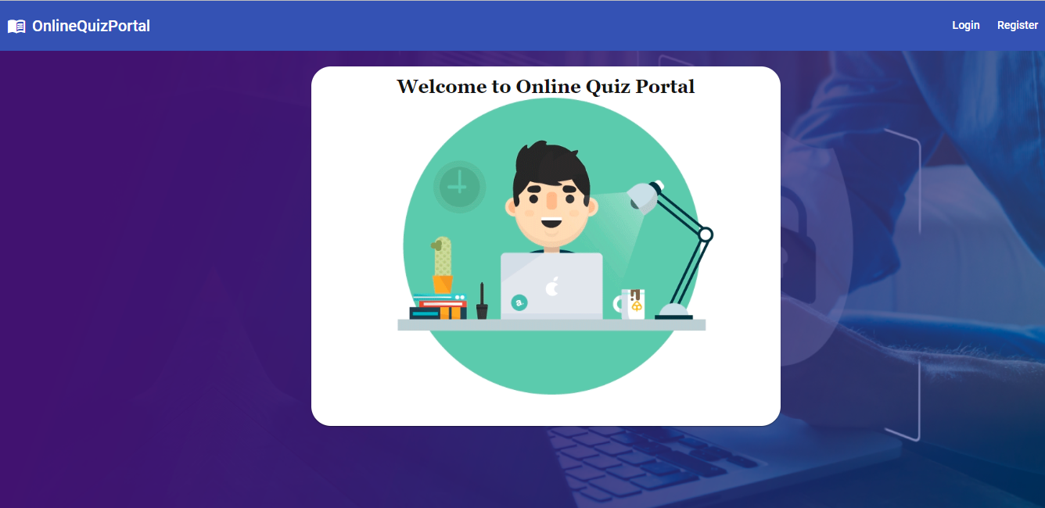
Home Page:

Slide 10
THANK YOU !

